Slide 1
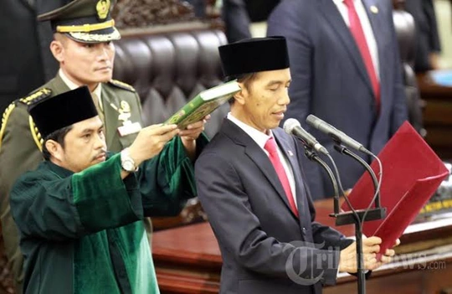
JOKOWI’S SECOND TERM:
ECONOMY OVER DEMOCRATIC REFORM
Burhanuddin Muhtadi, MA, Ph.D
Jakarta, 9 Desember 2019

Slide 2
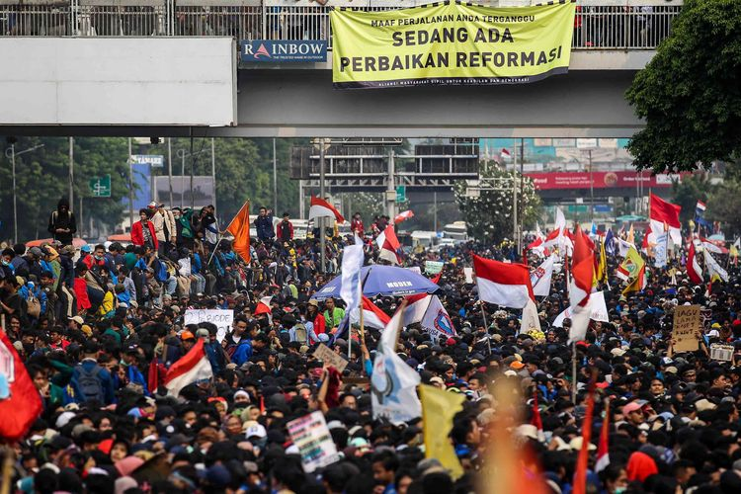
Background
Unlike the euphoria surrounding his first victory in 2014, Jokowi’s second term starts in a much more sombre mood.
Imminent threat toward democratic consolidation and anti-corruption agenda.
The personal factors contribute to this trend: as a technocratic populist and his preference on economic development.
The structural consolidation of oligarchic political elites.
Further erosion of democratic values gained during post New Order.

Slide 3
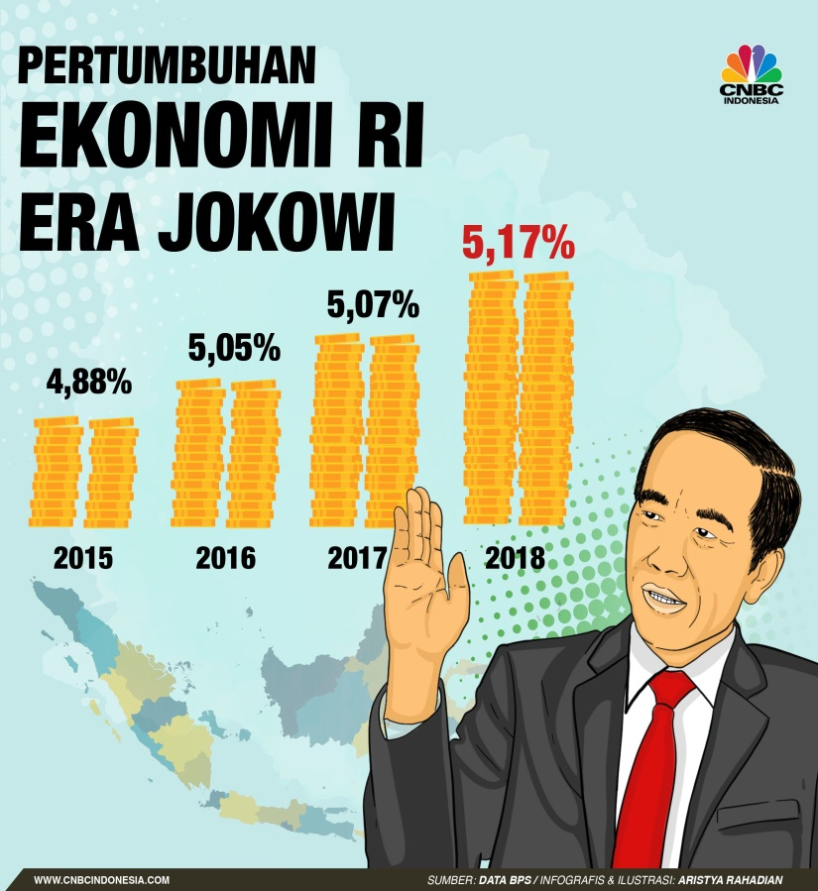
Economy remains his priority
The economy will remain his main priority. Infrastructure development, human resource development, further investment sectors and the perennial issue of bureaucratic reform.
Missing from Jokowi’s speeches was a focus on the agenda of human rights and the eradication of corruption.
There are a number of reasons: by emphasising economic issues, Jokowi encounters less opposition and conflict with parliament.

Slide 4
What is the MOST important issue for Indonesia right now? (Up to three)
What is the MOST important issue for Indonesia right now? (Up to three)
1. Economic management and growth | 2. Agriculture, food, fishery
3. Wages, income, salaries | 4. Natural disaster
5. Crime, law enforcement, security | 6. Industrial development
7. Political stability | 8. Unemployment
9. The environment | 10. Poverty
11. Justice | 12. Education
13. Enforcing women's right | 14. Infrastructure and transportation
15. Political reform | 16. Healthcare services
17. Child protection | 18. Ensuring human and civil rights
19. Foreign policy | 20. Fighting communism
21. Defence | 22. Protecting religious and ethnic minorities
23. Corruption | 24. Taxes
25. Price stability and inflation | 26. Drugs
27. Lack of moral values | 28. Social welfare
29.Other: ………………………………………………… | 88. DK/DA
4

Slide 5
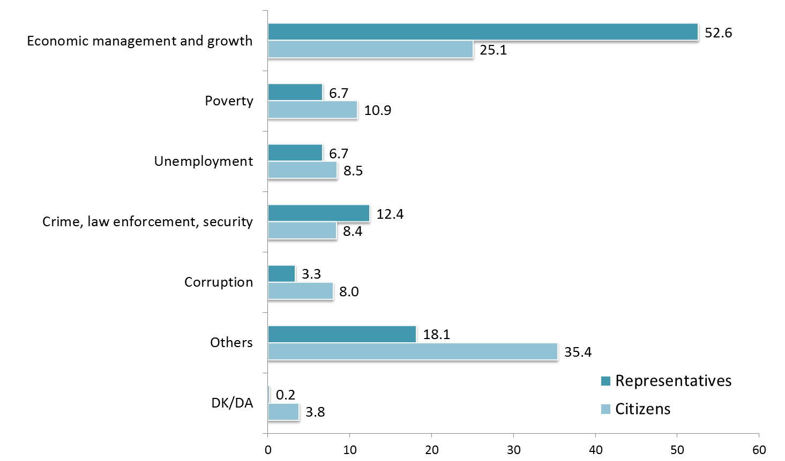
Most important issues (Top five based on respondents first choice

Slide 6
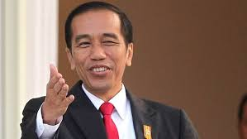
Personal factor
The second reason is personal character. Jokowi’s political outlook is a combination of non-ideological technocratic pragmatism and social empathy for the poor.
Jokowi tends to view non-economic issues as secondary, or merely as instruments to advance economic development.
Democracy is only a ‘tool’ to achieve the goals of people’s welfare. This view is problematic because people’s welfare can be achieved without democracy, as in the cases of China and Vietnam.

Slide 7
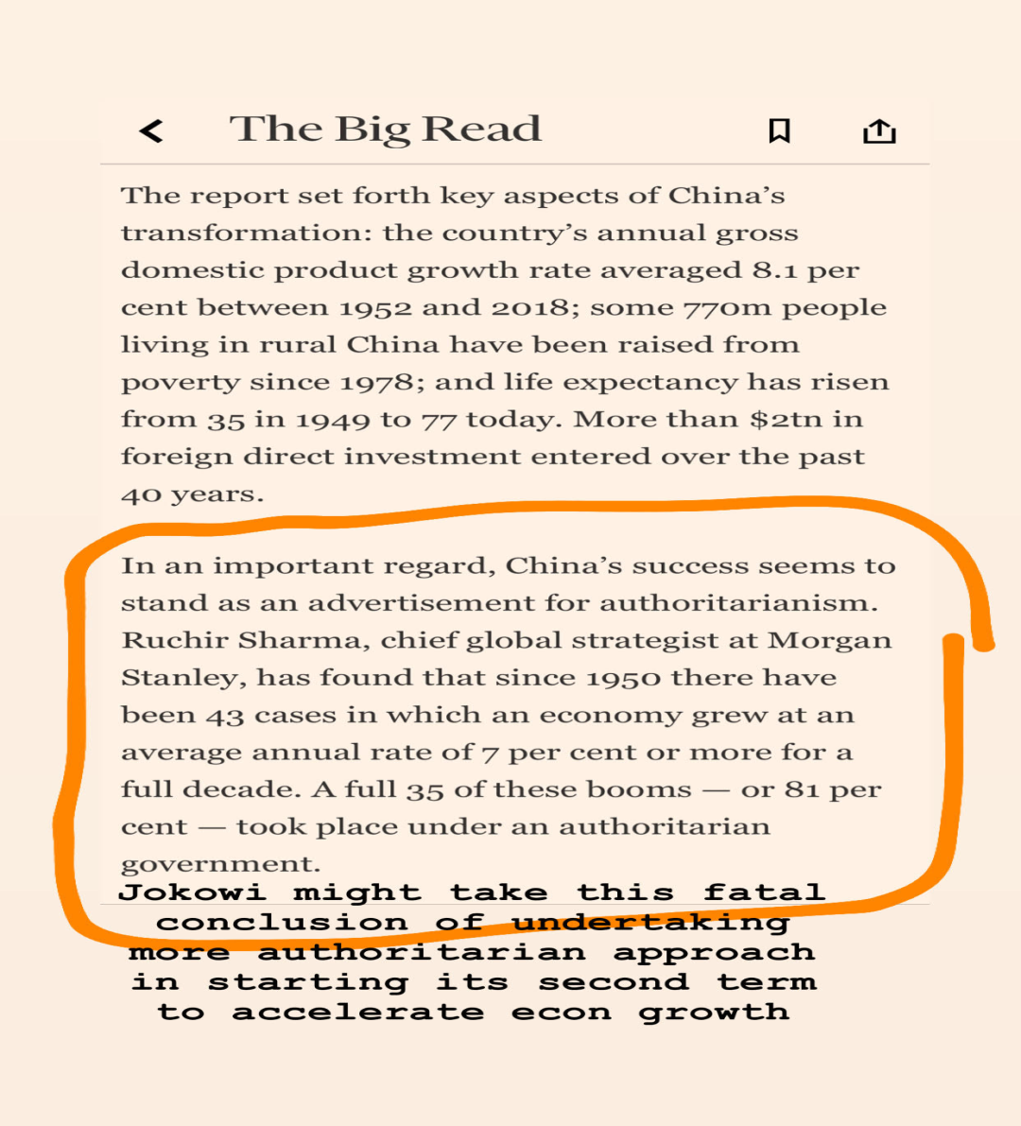
State led authoritarian capitalism

Slide 8
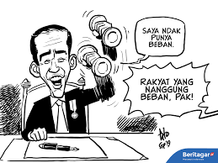
Constitutional term limit and an unburden claim
Almost no significant difference between the main agendas of Jokowi’s first and second term.
The game-changing factor is the constitutional term limit. Many predict that his performance will be less unconstrained by the electoral burden in his last term.
His ‘without burden’ statement was made in the context of economic reform. Jokowi will be more courageous in carrying out unpopular economic policies to fulfil the commitment to the economic reforms.
BPJS, energy reform, revision on Labour Law 13 of 2003.

Slide 9
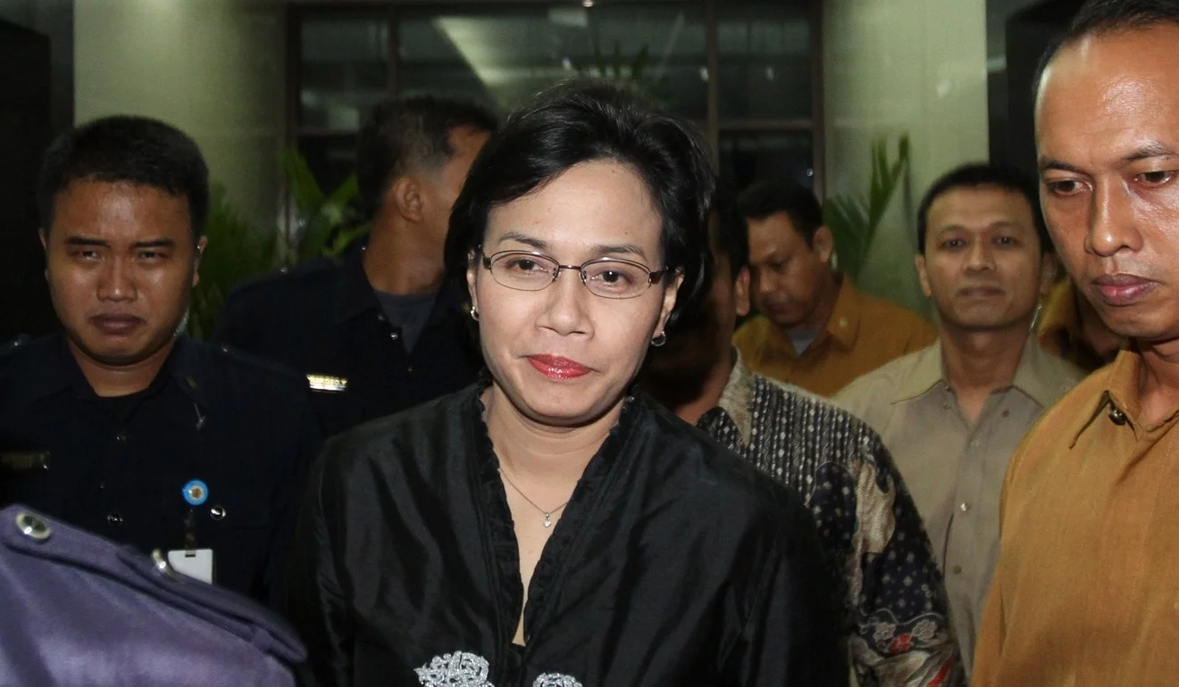
Cabinet: The good, the bad, and the ugly
Although Jokowi cannot run again in 2024, his coalition parties still need to compete in the next election.
Jokowi added Gerindra to his parliamentary coalition in anticipation of defections if he launched controversial policies.
Although his coalition looks secure on paper, the supporting parties are not controlled directly by Jokowi.
Cabinet is a mix of “the good, the bad, and the ugly” of politicians and professionals.
NU is the unhappiest group since the formation of the cabinet.
Competing oligarchs surrounding Jokowi: Megawati, Surya Paloh, Luhut Panjaitan dan Prabowo.

Slide 10
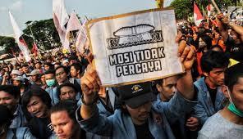
More conservative in second term?
Jokowi’s reluctance to pursue democratic reform also stems in part from his inability to run for election again in 2024.
In his first term Jokowi still had electoral incentives to demonstrate his concern for the trusted law-enforcement institution, the KPK.
There is potential for Jokowi’s second term to be more conservative when it comes to maintaining political stability and tolerating dissent.
The entrenched oligarchic forces have exploited Jokowi’s indifference towards democratic reform and anti-corruption efforts.
To amend the 1945 Constitution by reviving GBHN. If the amendment were to be passed, it might open a Pandora’s box that would include amending the presidential election system.

Slide 11
Second-term curse
Second-term curse in the US politics.
The economic performance of the president in the second period was actually not as good as the first period.
Only three of the 11 presidents in the US produced better economic performance in the second period than in the first term of office.
Public support for SBY in the early of his second term was better than Jokowi.
Do structural but unpopuler reforms as soon as possible, at least before the end of 2022.

Slide 12
Polarization and Road to 2024

Slide 13
Presidential Vote Based on Religion &
Islamic Organization ID
Muslim voters are fairly evenly divided into two candidate pairs, while non-Islamic voters showed solid support for candidate pair no 01. NU residents tend to vote for candidate 01, while Muslims affiliated with Muhammadiyah and other mass organizations and non-affiliates tend to choose candidate 02.
Exit Poll Pemilu 2019 | 13

Slide 14
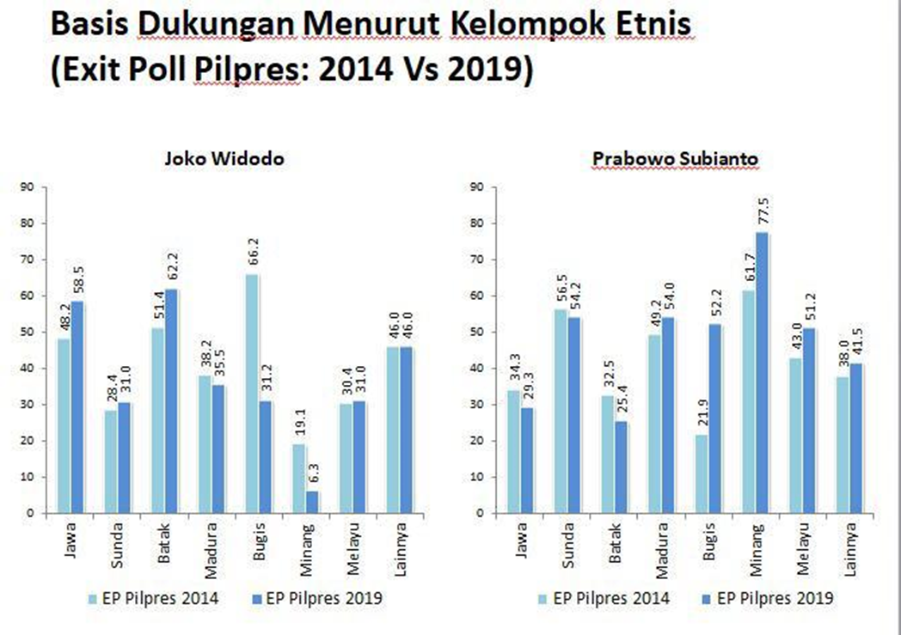

Slide 15
Elections were considered to be free and fair (%)
Status | Election Year | Base | Exit Poll | Post-election | Change
Loser | 2009 | 39.2 | 89.8 | 79.3 | -10.5
Winner | 2009 | 60.8 | 95.1 | 91.7 | -3.4
Loser | 2014 | 47 | 96.5 | 74.3 | -22.2
Winner | 2014 | 53 | 94.2 | 82.1 | -12.1
Loser | 2019 | 44.5 | 91.9 | 38.6 | -53.3
Winner | 2019 | 55.5 | 95.3 | 88.9 | -6.4

Slide 16
Indicators of democratic deterioration 2009, 2014 & 2019 (% of those who said always and often)

Slide 17
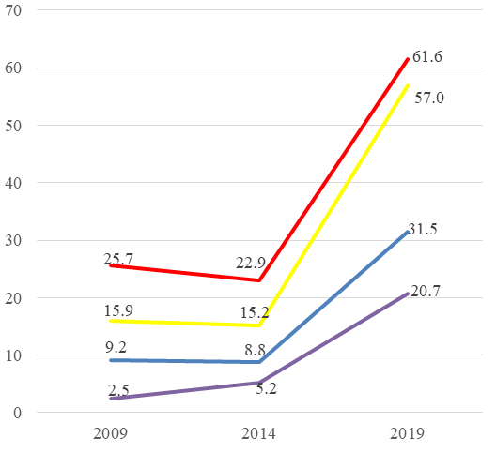
Democratic deterioration among winners (left panel) and losers (right panel), 2009, 2014 and 2019

Slide 18
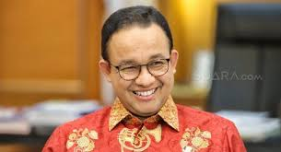
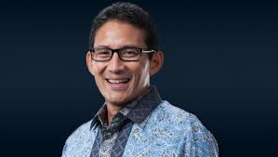
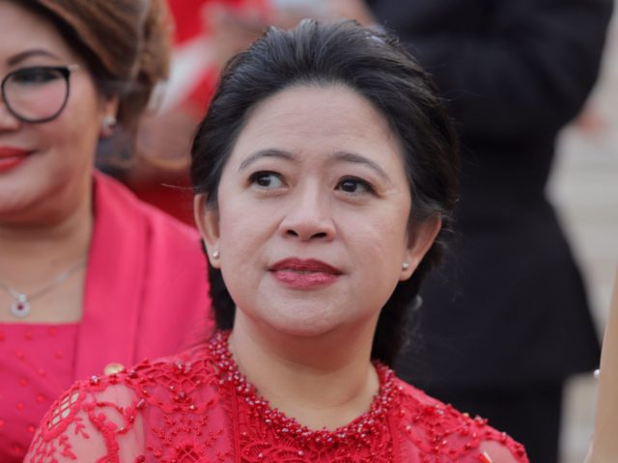
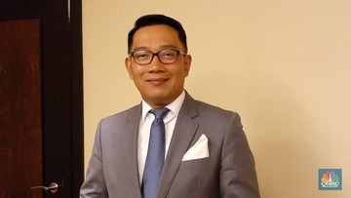
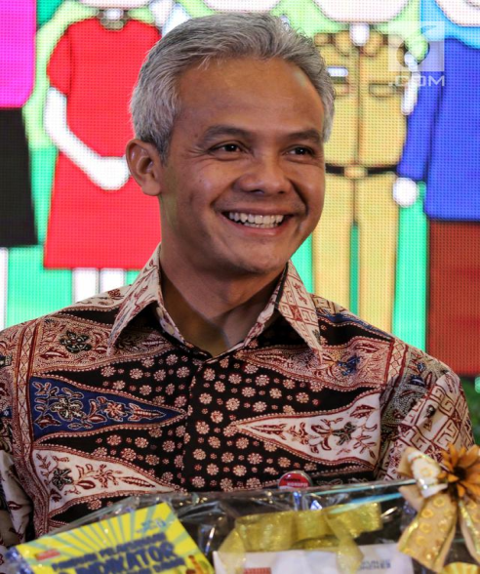
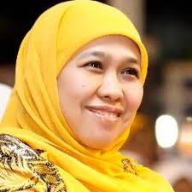
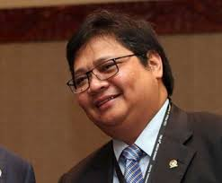
Potensial candidates for 2024

